Slide 1
Modeling the Baltimore City Emergency 911 Calls For Service 2019
Presented by Hugues Nelson Iradukunda
DATA 602: Intro to Data Analysis and Machine Learning
Professor Christopher McGraw

Slide 2

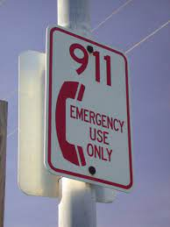
Overview of the project
Baltimore city is known to have a significant high crime rate that is considered above the national average.
Data source: Baltimore 911 Calls from 2019.
Collected a suitable dataset to perform a classification modeling task as a DATA 602 student.
Not All Emergency Calls are Emergency!

Slide 3
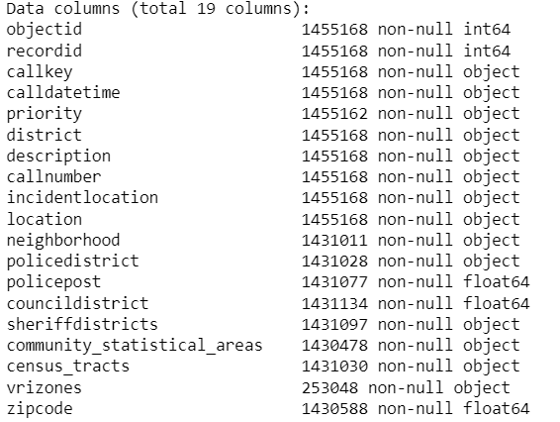
Exploratory Data Analysis (EDA)
The original dataset consists:

Slide 4
Exploratory Data Analysis (EDA)
Then, I cleaned the missing and duplicated data.
I performed feature engineering by:
Transforming the call time recorded in the raw data
Extracting month, days in the year of 2019

Slide 5
Exploratory Data Analysis (EDA)
I plotted the heatmap to see correlation between attributes
I visualized and plotted the distribution of certain features including the target (priority calls) as well as the relationship between two attributes.
I plotted the trends of each priority calls throughout the year.

Slide 6
Model Results
Machine learning models chosen for exploration:
Logistic Regression
Logistic Regression with grid search cross-validation k fold
Results:
Training accuracy score with Logistic Regression: 98.12%
Testing accuracy score with Logistic Regression: 95.67%
Grid search validation best score: 95.69%

Slide 7
Conclusions
Motivation towards the techniques chosen:
Logistic regression is the most common classification model to use for this type of problem (multi labels/classes classification).
I found the best model based on grid search
The baseline model and the grid search achieved a high accuracy score close to 96 percent.
Potential ways to improve performance & Areas for further exploration:
Running other Decision Tree Algorithms and see if it has any impact.

Slide 8
References
https://github.com/appliedecon/data602-lectures
https://scikit-learn.org/stable/modules/linear_model.html#logistic-regression
https://data.baltimorecity.gov/datasets/baltimore::911-calls-for-service-2019/about

Slide 9
Thank you

